Slide 2
David and Travis
(Creators of Pink Shirt Day)

Slide 4
!Stop Bullying!
Take a stand against bullying. Together we can fight bullying.

Slide 6
This is what bullying is. And that is not OK.
Unacceptable!

Slide 7
Cyberbullying It is a new form of bullying. Here are some examples of cyberbullying:

Slide 8
No one deserves that. Think before treating anyone like that.

Slide 9
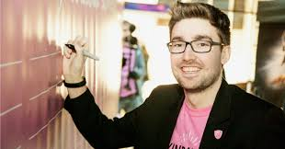
Vous êtes conviés à porter du rose le 24 Février 2021 pour soutenir ce mouvement de rejet du harcèlement
Come in wearing something pink.
We all have a role to play!
Nous sommes tous concernés.
Nous comptons sur votre solidarité!

